Slide 1
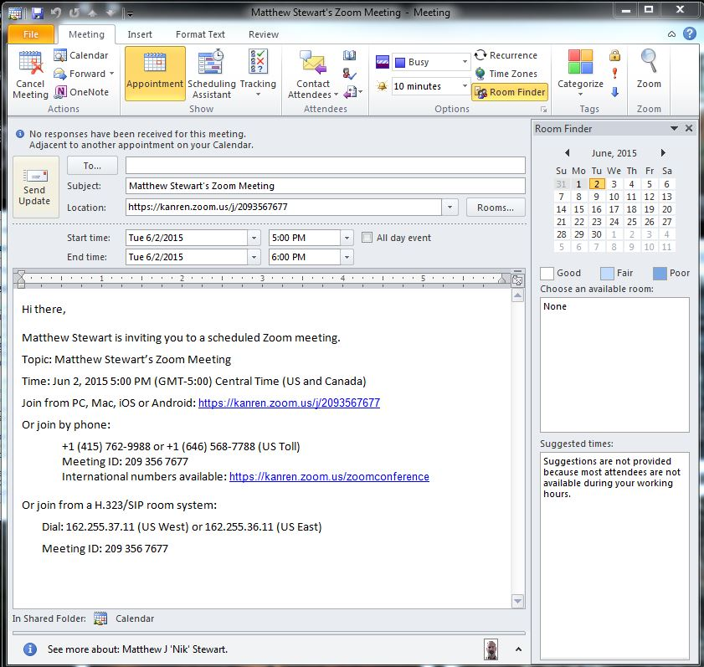
Zoom Scheduling
Simplified scheduling, including instant meetings
Scheduling is compatible with Outlook and Gmail

Slide 2
Zoom User Experience
Multi-platform compatible
Phone, Cell, PC, Mac, ITV
Open ended meetings as needed
Early arrivals can be scheduled to meet in a lobby before the host connects, no ‘instant on’ meetings
Join, leave, and rejoin freely
Voice, VOIP, video as available
File sharing available

Slide 3
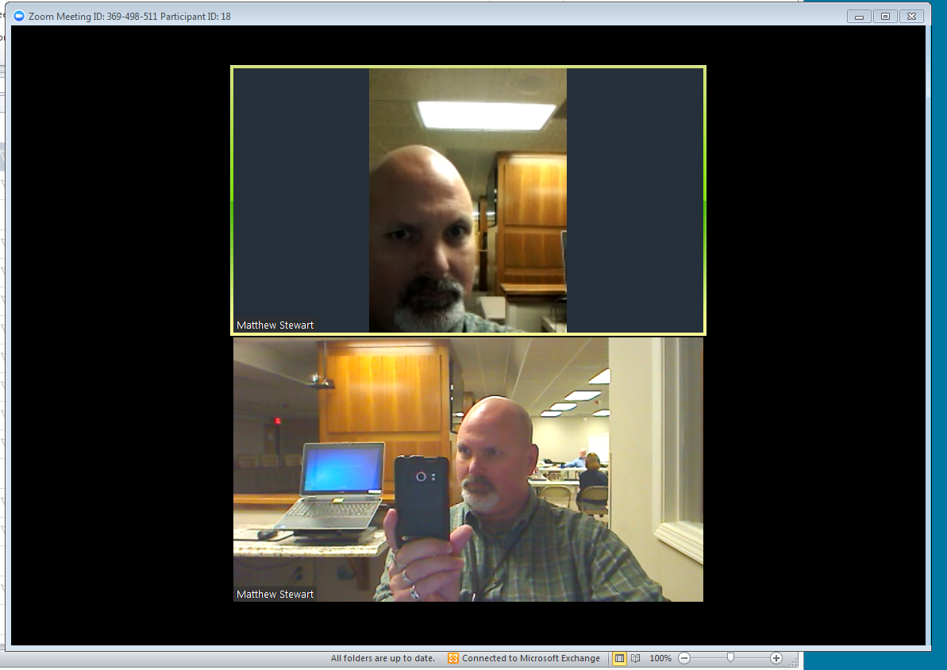
Zoom User Experience
The software installation is small, Flash based.
Joining is as easy as typing in the meeting ID
The software will shut off the local microphone if it detects an echo

Slide 4
Simple screenshares
CLICK

Slide 5
Simple screenshares
CLACK

Slide 6
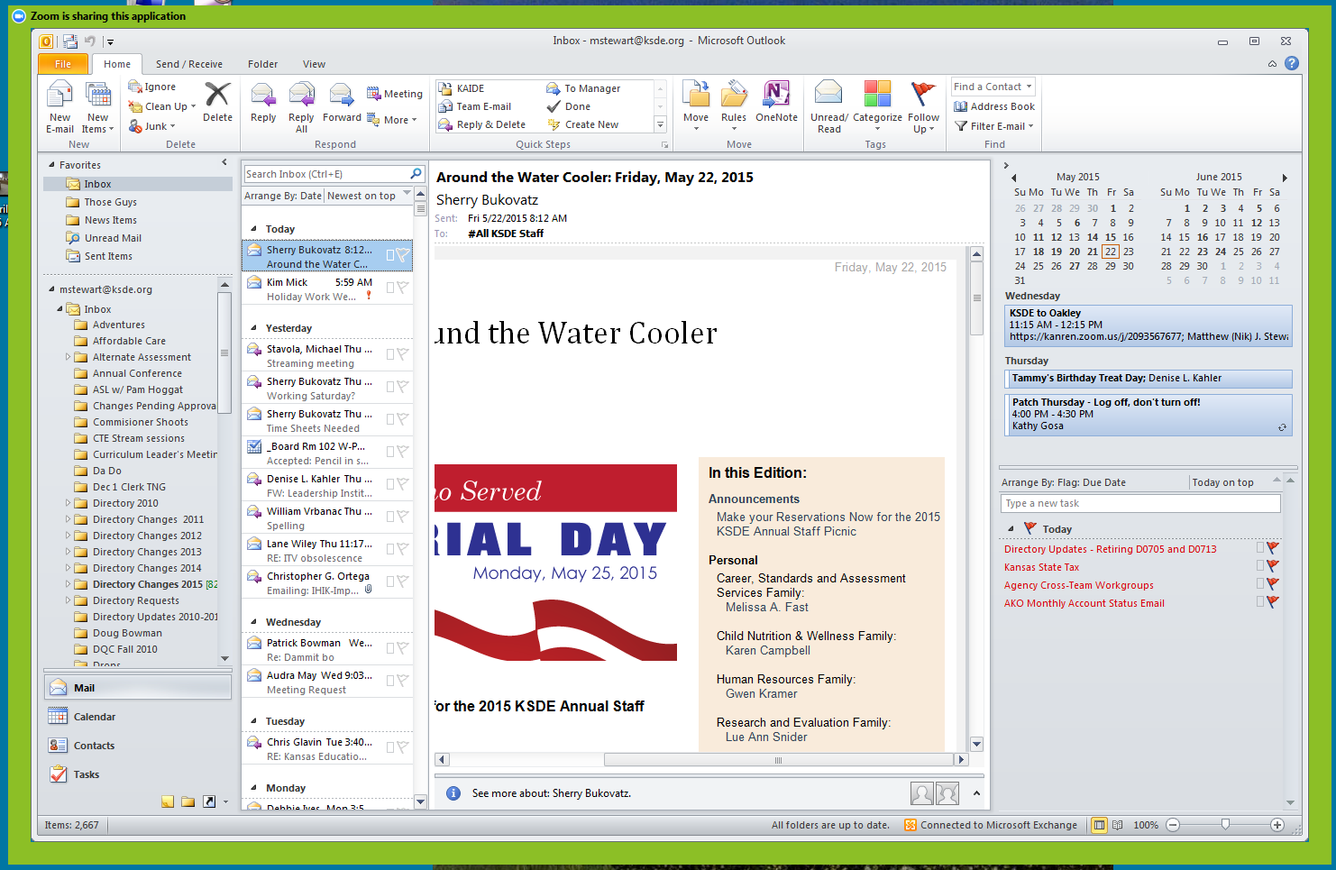
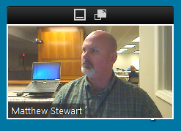
Simple screenshares
BLADAU
Automatically creates thumbnail to maintain eyeline with audience

Slide 7
Zoom Logistics
128bit AES encryption available
Will slow connection but helps protect content
Can connect with older ITV systems.
$5000/year for entire site (250 licenses)
Offloads hardware and support to vendor
Platform fungibility (PC Mac iOS Android Blackberry, Linux is in testing)

Slide 8
Zoom Elements
File sharing limited to group members (+/-)
Group membership requires signing up (-)
Service can be free for 30 days (+)
Signing up only required for file sharing; joining meetings can be anonymous (+)
Google Docs recommended for outside users.
Will freeze; can be contagious (one station failing can cause others to fail)
Reboot fixes

Slide 9
Wired, Wireless laptop, Android phone
(This camera is mirrored)

Slide 10
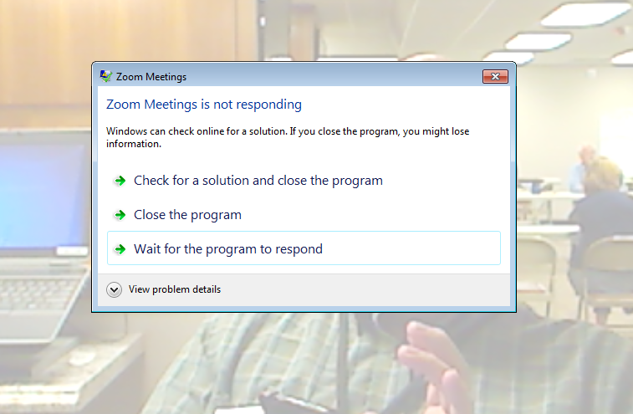
Zoom Elements
Will freeze; can be contagious
Reboot fixes

Slide 11
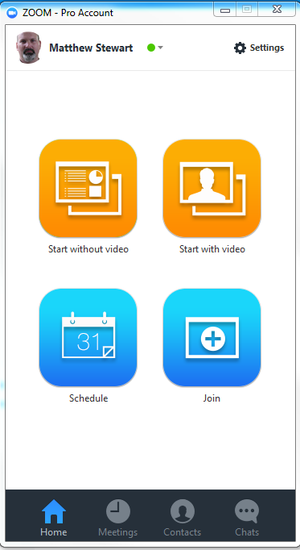
Instant meeting; sound and audio optional ➔
⬅ Instant meeting; start with video and audio
Schedule a meeting➔
⬅ Join a meeting in progress

Slide 12
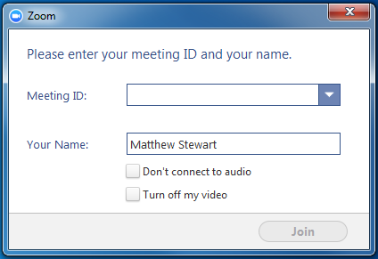
⬅ Schedule
Join

