Slide 1
Kansas Education Overview
October 19, 2011

Slide 2
Kansas State Board of Education
General Supervision of Public K-12 Schools
Accrediting K-12 schools
Administering & distributing state & federal funds
Certifying teachers, administrators & school specialists
Developing, administering & monitoring state & federal plans
Developing curricular standards
Evaluating & approving teacher education programs
Public hearings: state plans, rules & regulations, transfers of territory, due process appeals
Supervising KSSB & KSSD

Slide 3
Kansas State Board of Education
10 elected Board members
Four-year terms
Membership based on distribution of population among 40 state senate districts
Four state senate districts per Board district

Slide 4
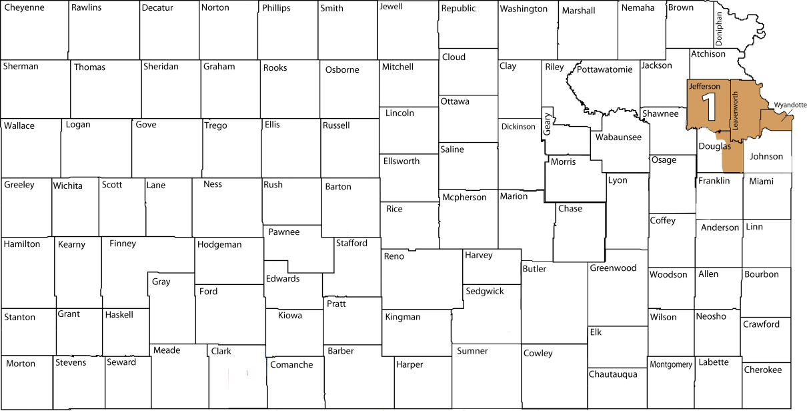
District 1 ~ Janet Waugh
Counties: Jefferson Leavenworth; portions of Douglas, Wyandotte
Congressional Districts: 2 & 3
State Senate Districts: 3, 4, 5, 6
19 school districts

Slide 5
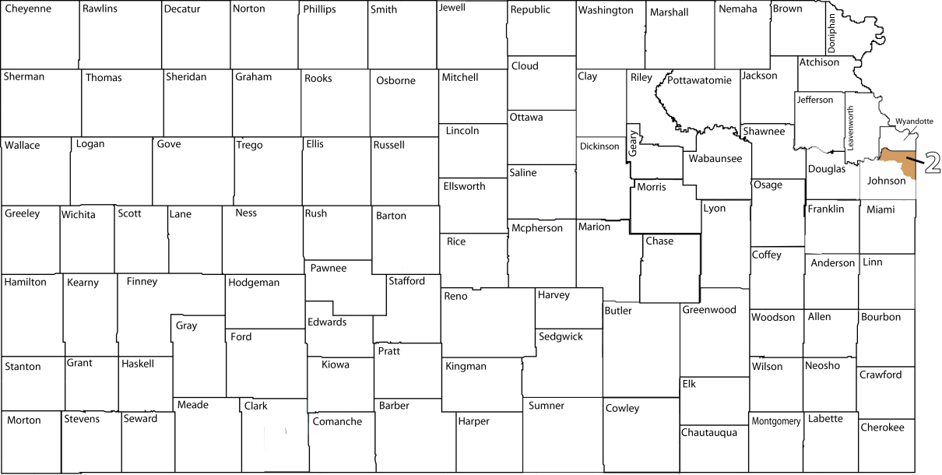
District 2 ~ Sue Storm
Counties: Portions of Johnson and Wyandotte
Congressional District: 3
State Senate Districts: 7, 8, 10, 11
Three school districts

Slide 6
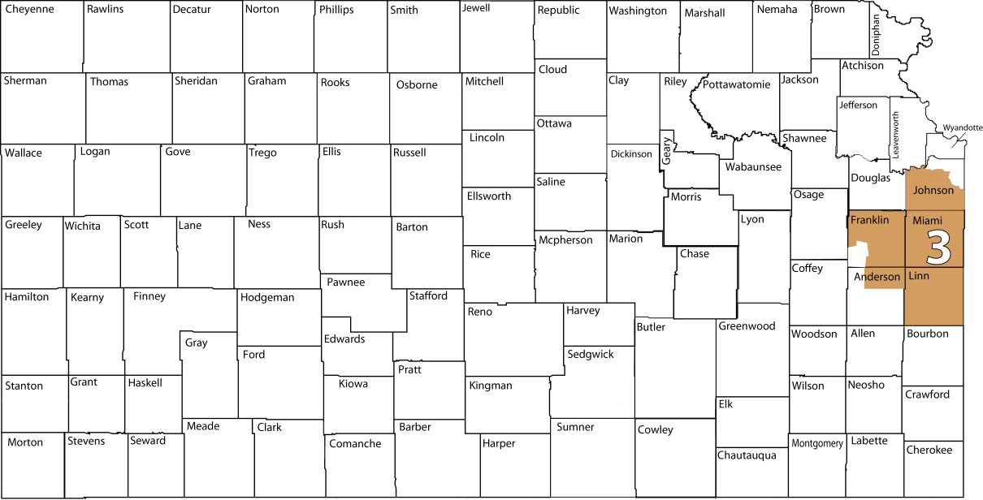
District 3 ~ John W. Bacon
Counties: Linn, Miami; portions of Anderson, Franklin, Johnson
Congressional Districts: 2 & 3
State Senate Districts: 9, 12, 23, 37
17 school districts

Slide 7
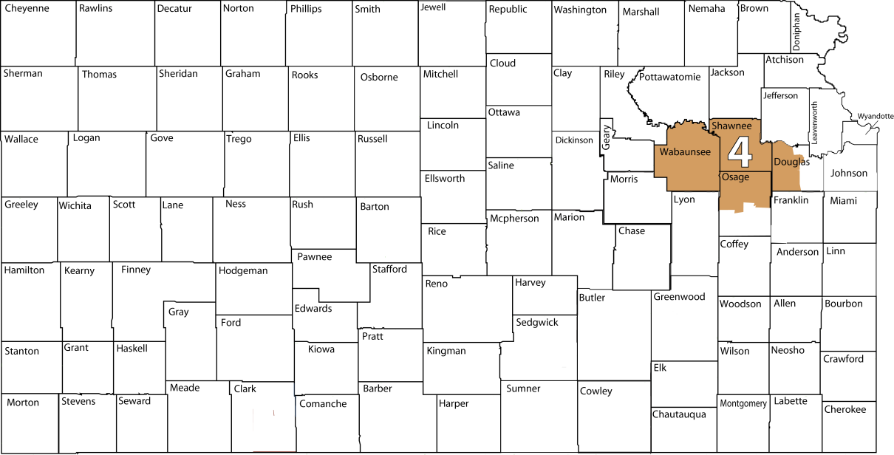
District 4 ~ Carolyn Wims-Campbell
Counties: Shawnee, Wabaunsee; portions of Douglas, Osage
Congressional Districts: 2 & 3
State Senate Districts: 2, 18, 19, 20
12 school districts

Slide 8
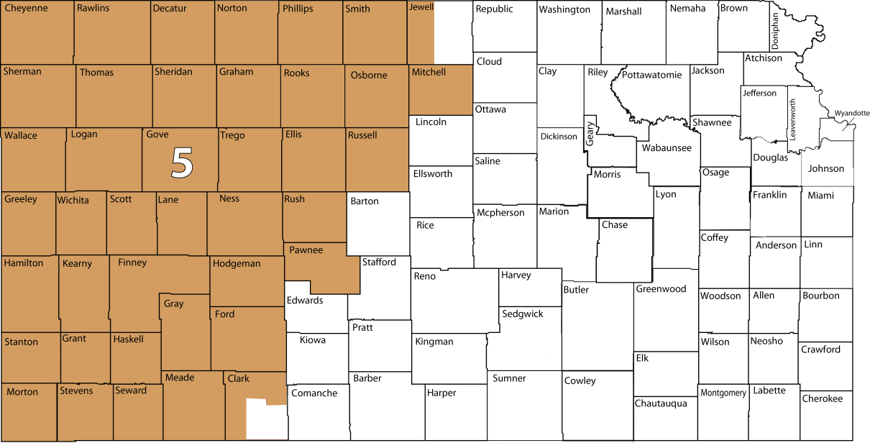
District 5 ~ Sally Cauble
Counties: Cheyenne, Decatur, Ellis, Finney, Ford, Gove, Graham, Grant, Gray, Greeley, Hamilton, Haskell, Hodgeman, Kearny, Lane, Logan, Meade, Mitchell, Morton, Ness, Norton, Osborne, Pawnee, Phillips, Rawlins, Rooks, Rush, Russell, Scott, Seward, Sheridan, Sherman, Smith, Stanton, Thomas, Trego, Wallace, Wichita; portions of Clark, Jewell
Congressional District: 1
State Senate Districts: 36, 38, 39, 40
73 school districts

Slide 9
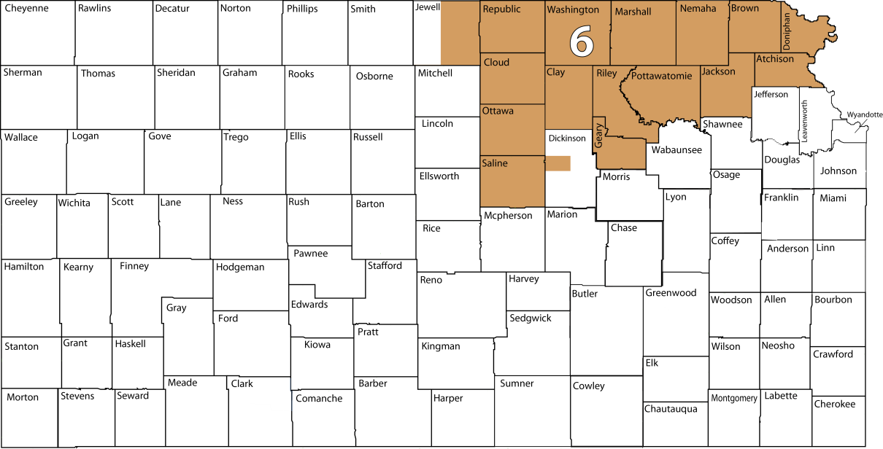
District 6 ~ Kathy Martin
Counties: Atchison, Brown, Clay, Cloud, Doniphan, Geary, Jackson, Marshall, Nemaha, Ottawa, Pottawatomie, Republic, Riley, Saline, Washington; portions of Dickinson, Jewell
Congressional Districts: 1 & 2
State Senate Districts: 1, 21, 22, 24
41 school districts

Slide 10
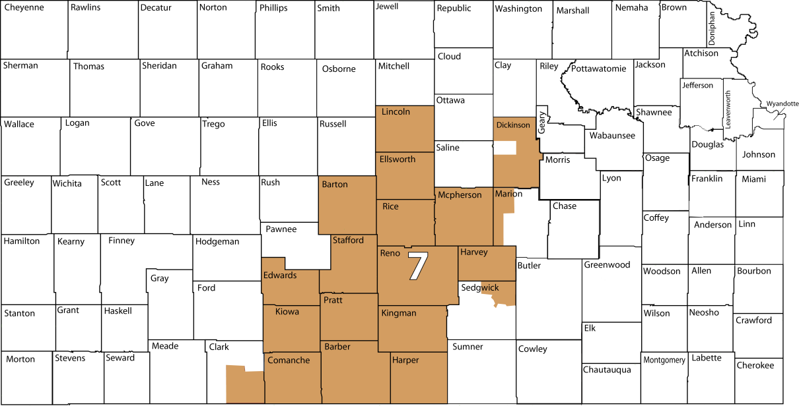
District 7 ~ Kenneth Willard
Counties: Barber, Barton, Comanche, Edwards, Ellsworth, Harper, Harvey, Kingman, Kiowa, Lincoln, McPherson, Pratt, Reno, Rice, Stafford; portions of Clark, Dickinson, Marion, Morris, Sedgwick
Congressional Districts: 1 & 4
State Senate Districts: 31, 33, 34, 35
51 school districts

Slide 11
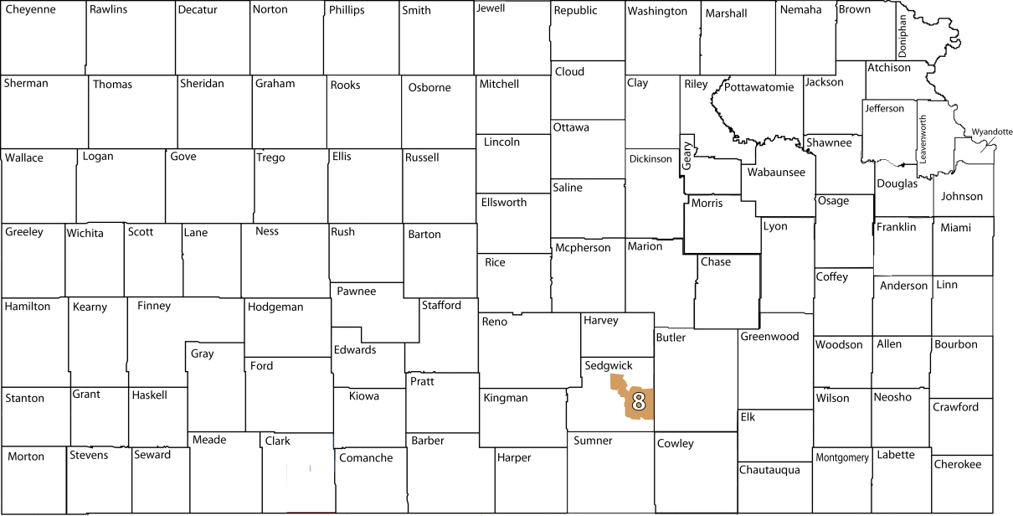
District 8 ~ Dr. Walt Chappell
Counties: A portion of Sedgwick
Congressional District: 4
State Senate Districts: 25, 28, 29, 30
Four school districts

Slide 12
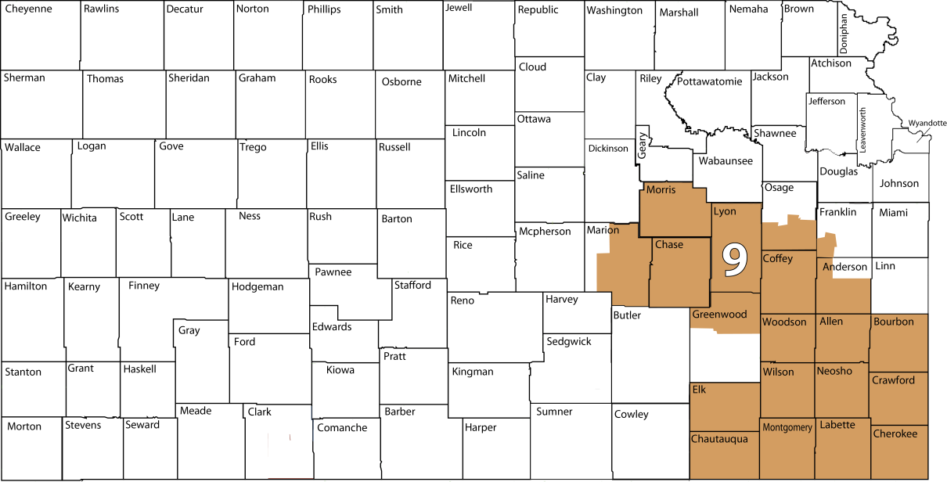
District 9 ~ Jana Shaver
Counties: Allen, Bourbon, Chase, Chautauqua, Cherokee, Coffey, Crawford, Elk, Labette, Lyon, Montgomery, Neosho, Wilson, Woodson; portions of Anderson, Franklin, Greenwood, Marion, Morris, Osage
Congressional Districts: 1, 2 & 4
State Senate Districts: 13, 14, 15, 17
52 school districts

Slide 13
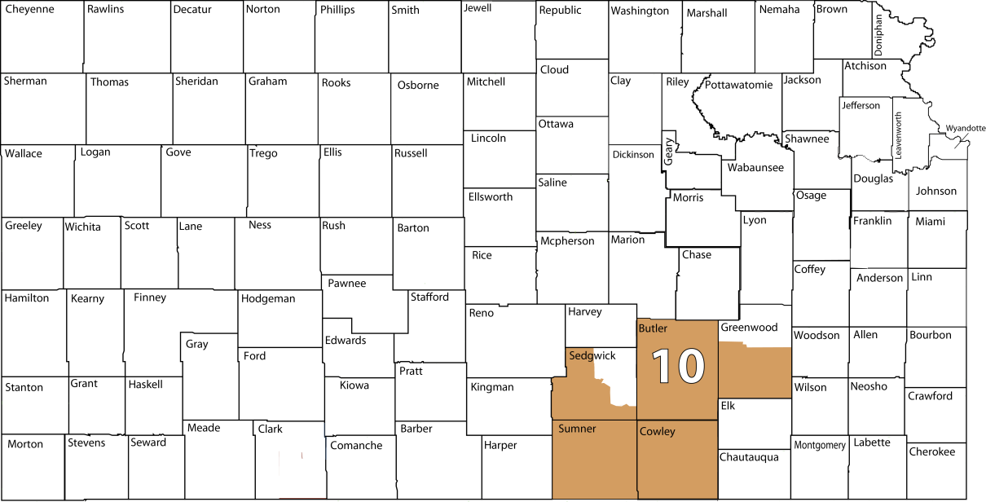
District 10 ~ David Dennis
Counties: Butler, Cowley, Sumner; portions of Greenwood, Sedgwick
Congressional Districts: 1 & 4
State Senate Districts: 16, 26, 27, 32
30 school districts

Slide 14
Kansas State Department of Education
Carries out policies of State Board
Assists schools in state & federal compliance
Assists in implementing best practices based on research

Slide 15
Local Boards of Education
Curriculum/text books
Schedules
Teacher hiring/evaluation
Salaries

Slide 16
United States Department of Education
Foster educational excellence and ensure equal access
10% of school funding nationwide
Title I
Vocational Education/Career and Technical Education

Slide 17
Elementary & Secondary Education Act
ESEA, also known as No Child Left Behind
Due to be reauthorized

Slide 18
Blueprint for Reform
College-and career-ready students
Great teachers & great leaders in every school
Equity & opportunity for all students
Raise the bar and reward excellence
Promote innovation & continuous improvement

Slide 19
NCLB Waiver Requirements
College and Career ready standards and assessments
Differentiated accountability, recognition and support system
Teacher and principal evaluation system
Reduction in reporting requirements

Slide 20
Common Core State Standards
47 states and jurisdictions
Coordinated by National Governor’s Association and Council of Chief State School Officers
Standards for English/language arts and mathematics
Developed in collaboration with teachers, administrators and experts
Evidence based and internationally benchmarked
Include content and application of knowledge

Slide 21
Next Generation Science Standards
Kansas named a lead state in effort
Help guide standards writing process
Provide feedback and direction
Coordinated by National Research Council
Standards development process managed by Achieve
Focus on defining and integrating science and engineering content and practices

Slide 22
Common Core Standards
Advantages
More focused & more rigorous
Aligned with college and work expectations
Build on strengths of current standards
Can add content to reflect state emphasis
Can benefit from successful strategies and programs in other states
Can pool resources for assessment development

Slide 23
SMARTER Balanced Assessment
Consortium of 29 states
Developing next generation of assessments
$160 million federal grant

Slide 24
SMARTER Balanced Assessment
Differences from current assessment:
Won’t be all multiple choice
Performance based
Technology enhanced
Computer adaptive
Advantages
Addition of performance piece
Won’t have to do one-point-in-time assessment
Share costs to develop assessment

Slide 25
Differentiated Accountability System
Reduce by half the percentage of students in the “all student” group and in each subgroup who perform below standards within six years
Increase in annual performance targets toward a goal of having 100% of students proficient or above by the end of the 2019-2020 school year
Another method that is educationally sound and results in ambitious but achievable annual, measurable objectives for all LEAs, schools and subgroups

Slide 26
Growth Model
Accountability measured by set target and progress over time
Applies to individual students as well as schools

Slide 27
21st Century Accreditation Model
Replace Quality Performance Accreditation system
Early stages of development
Working with educators in field

Slide 28
Teacher/Principal Evaluation
KEEP – Kansas Educator Evaluation Protocol
Being piloted this year
Working to add tie to student growth measures

Slide 29
Waiver Flexibility
2014 timeline for achieving 100% proficiency
School improvement requirements
Use of federal funds for school improvement
Additional flexibility for rural schools

Slide 30
Waiver Timeline
Submission of Waiver
First opportunity November 2011
Second opportunity February 2012
Response to Waiver
Expect to know if waiver granted by end of May 2012

Slide 31
We Need You!
Great Opportunities
Great Challenges

Slide 32
Questions?

Slide 33
Thank you

