Slide 1
Overview of ICT Accessibility
Cole Robison
Director of IT Accessibility
Office of Information Technology Services
(785) 291-3016
cole.robison@ks.gov

Slide 2
Accessibility
Accessibility is the usability of a technology or service by everyone, including people with disabilities.
  Usability encompasses not only perception and understanding, but also navigation and interaction.
  Accessible ≈ barrier-free

Slide 3
Types of Disabilities
There are many types of disabilities to consider in addressing barriers:
  Blindness and visual impairment
  Deafness and hearing impairment
  Speech and language
  Physical
  Cognitive

Slide 4
Common Challenges for Users with Disabilities
Navigating and locating content
Reading order of content
Lack of labels, instructions, and cues for input elements
Access to and understanding of non-text elements
  Lack of text alternatives for illustrations, charts, graphs, screenshots, icons and audio/video content
  Reliance on color, shape, or location alone to convey meaning
Improper text formatting and structure
  Color contrast, headings, lists, etc.
Lack of information about content roles, relationships and states
  Data cells and header cells in a table, etc.
  Currently selected item
Inability to navigate to and activate objects with the keyboard or equivalent
Inability to track or control focus changes

Slide 5
Assistive Technology
Assistive technologies (AT) are devices that help individuals with disabilities in the use or access of something.
Examples include canes, wheelchairs, and lever-shaped doorknobs.

Slide 6
Assistive Technology: ICT
Examples of assistive technology for ICT users:
  Screen readers
  Refreshable Braille displays
  Screen magnifiers
  Onscreen or other special keyboards
  TDD/TTY and video relay devices
  Text-to-speech software
  Word prediction software

Slide 7
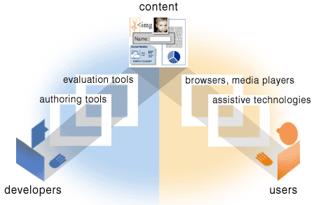
Essential Components of Accessibility
Source: http://www.w3.org/WAI/intro/components.php

Slide 8
Example Scenarios
A person who is blind uses a screen reader or Braille display, and benefits from text alternatives to images.
An individual who is deaf benefits from captions in video.
A person with a motor disability benefits from keyboard equivalents for mouse-driven commands.
For more, see http://www.w3.org/WAI/intro/
people-use-web.php.

Slide 9
Usability for All
For all of this discussion of types of disabilities, etc., it is also important not to segregate.
We shouldn’t regard a technology as having “users” and “users with disabilities.”
Rather, it simply has users, and those users are diverse and span a full spectrum of differing abilities.
From this perspective, accessibility is not an add-on, it is a core requirement.
For more, see http://alistapart.com/article/reframing-accessibility-for-the-web

Slide 10
Importance: Social Factors
Equal opportunity
Economic, social, and civic inclusion
  Talent, skill, and productivity
Digital independence
  ICT can offer unprecedented potential for removal of barriers
  http://richardsnotes.org/2003/07/28/
  digital-independence/
The Right thing to do
  A moral imperative in our participatory society
  Both good business and good ethics

Slide 11
Importance: Legal & Policy Factors
Conformance with the law
Minimize legal risk
  Complaints, litigation, damages, injunctions: costly!

Slide 12
Importance: Significance
About 357,000 Kansans have disabilities
  59,000 have difficulty seeing
  111,000 have a hearing difficulty
  180,000 have ambulatory limitations
  132,000 have cognitive difficulties
Rates of disability are expected to increase rapidly due to population aging and increases in chronic health conditions, among other causes.
At one point or another, we all experience a disability of some kind.
Source: Erickson, W. Lee, C., & von Schrader, S. (2016). 2015 Disability Status Report: Kansas. Ithaca, NY: Cornell University Yang Tan Institute on Employment and Disability (YTI).

Slide 13
Other Beneficiaries of Accessible Technology
Accessible web sites can benefit people with low literacy levels and people who are not fluent in the language of the site.
  10.5% of Kansans speak a language other than English at home. (Source: 2010 Census)
Some aspects of web accessibility benefit people with low bandwidth connections.
  Rural locations
  Financial situation (“Digital divide”)
  Mobile technology
Removal of barriers benefits all
  Situational disability
    https://www.w3.org/WAI/perspectives/

Slide 14
ICT Accessibility
ICT represents a double-edged sword: it offers great potential, but can also present barriers.
The difference lies in the implementation.

Slide 15
Example

Slide 16
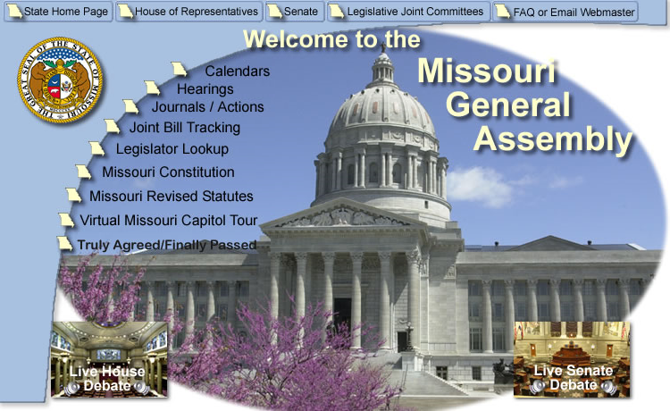
Sample Web Page
Notes:
In fairness, this page has been doctored for this example! The real page was at http://www.moga.mo.gov/, but has since been redesigned.

Slide 17

Same Page without Images
Notes:
Actual browser screenshot. (Firefox with Web Developer extension, images replaced with alt attributes)

Slide 18
Better Implementation

Slide 19
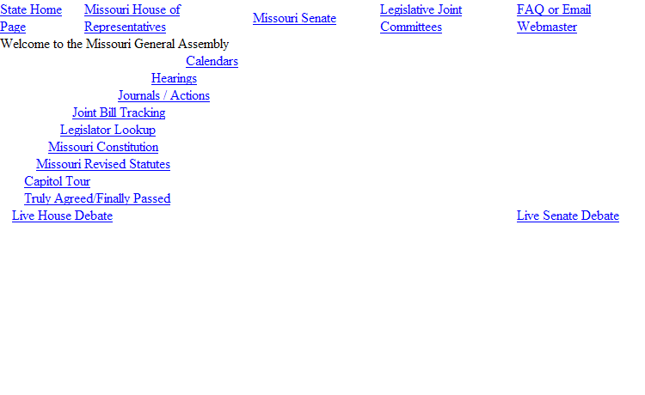
Now without Images

Slide 20
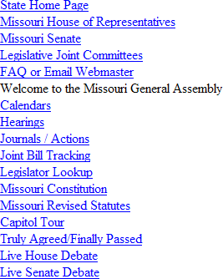
What a Screen Reader Might Present

Slide 21
Applicable Laws: State
Rights of persons with disabilities (K.S.A. 39-1101)
Rights of persons with disabilities; employment (K.S.A. 39-1105)
Kansas Act Against Discrimination (K.S.A. 44-1001 et seq.)
Accessibility standards for public buildings or facilities
(K.S.A. 58-1301 et seq.)

Slide 22
Applicable Laws: Federal
Americans with Disabilities Act of 1990 (ADA) (42 U.S.C. §§ 12101 et seq.)
Section 504 of the Rehabilitation Act of 1973, as amended (29 U.S.C. § 794)
Section 508 of the Rehabilitation Act of 1973, as amended (29 U.S.C. § 794d; implementing regulation: 36 CFR Part 1194)
Section 255 of the Communications Act of 1934, as amended by the Telecommunications Act of 1996
(47 U.S.C. §§ 255, 251(a)(2))
Twenty-First Century Communications and Video Accessibility Act of 2010 (CVAA) (Pub. L. 111-260)
Notes:
ADA
prohibits discrimination on the basis of disability
prevents employers from basing employment decisions on the basis of disability
ADA Title II: State and Local Government Activities (implementing regulation: 28 CFR Part 35)
requires that state and local governments give people with disabilities an equal opportunity to benefit from all of their programs, services, and activities
ADA Amendments Act of 2008 (Pub.L. 110–325)
effective January 1, 2009
significantly expanded the scope of the ADA
Section 504
Section 504 states that “no qualified individual with a disability in the United States shall be excluded from, denied the benefits of, or be subjected to discrimination under” any covered program or activity.
Section 508
Section 508 establishes requirements for electronic and information technology.
Directly applicable only to the Federal government
Adopted as a best practice by most US public sector organizations
Section 255
Section 255 and Section 251(a)(2) of the Communications Act of 1934, as amended by the Telecommunications Act of 1996, require providers of telecommunications services to ensure that such services are accessible to and usable by persons with disabilities.
CVAA
Amends the Communications Act
Addresses Advanced Communications Systems (ACS)
VoIP (interconnected or non-interconnected)
Electronic messaging (two-way communications)
Email, text, chat
Video conferencing
Mobile phone Internet browsers used on public mobile phone networks
Captioning requirements for broadcast content that is rebroadcast over the Internet
Access to user interfaces of video programming device
Easy access to caption and video description controls
Closed captioning transmission and decoding
Support for captions and video descriptions
Video description requirements
Top broadcast and cable/satellite providers
Not required on the Internet
Access to programming guides and menus
Access to emergency information
Relay services for the deaf and the deaf-blind
Hearing aid compatibility

Slide 23
Section 508 Applicability to School Districts
The Department of Education interprets the Assistive Technology Act (AT Act) to require States receiving assistance under the AT Act State Grant program to comply with Section 508, including the standards of the Access Board. Therefore, recipients of federal funds under the AT Act must comply with Section 508.

Slide 24
Revised Section 508: ICT Standards
Section 508 and Section 255 were just updated January 18, as Information and Communication Technology (ICT) Standards and Guidelines
  Re-organize standards to address product functionality rather than type
  Modernize standards
  Harmonize with industry standard for web accessibility
  Address certain types of content
  Clarify intention
  Address more types of disabilities
  Make more testable
For more, see https://www.access-board.gov/guidelines-and-standards/communications-and-it/about-the-ict-refresh.

Slide 25
Accessibility Standard Incorporated by Reference
Web Content Accessibility Guidelines 2.0 (ISO/IEC 40500:2012)
  By the World Wide Web Consortium (W3C)
  http://www.w3.org/TR/WCAG/
  Level AA conformance required

Slide 26
Core Concepts (1)
Textual alternatives
  Convey the state, identity, and operation of content
    Alternative text for images and image links
    Explicitly labeled form fields
    Equivalents for audio and video
Page/document structure
  Proper combination of structure in HTML code and presentation (e.g., CSS) (web content)
    Explicit headings
    Explicit list structures
    Reading order

Slide 27
Core Concepts (2)
Keyboard accessibility
  Ability for user to navigate to objects with the keyboard
  Ability for user to activate objects with the keyboard
  No keyboard traps
  Tab order
Focus control
  Provide a visual focus discernable while navigating with the keyboard
  Ensure assistive technologies can track the focus changes
  Avoid focus changes not initiated by the user

Slide 28
Typical Areas of Accommodation
Areas that typically require special attention for accessible implementation include:
  Non-text elements
  Color
  Page structure
  Lists
  Links
  Frames
  Navigation
  Data tables
  Forms

Slide 29
What Accessibility Is Not: Common Myths
Accessibility forces you to create two versions of your website
A text-only version satisfies the requirement for equal or equivalent access
Accessibility costs too much
Accessibility forces you to create primitive, low-end designs
Sites must look the same in all browsers and user agents
Source: Zeldman, Jeffrey. Designing with Web Standards. 3rd ed. New Riders, 2010. ISBN 978-0-321-61695-1.

Slide 30
Examples

Slide 31
Provide alternative text for images: web
Alternative text communicates the meaning of images to users of AT and text-only browsers.
Standards
  WCAG 2.0 Level A
    1.1.1 Provide text alternatives for all non-text content
<img src="library_map.gif"
alt="Library Map">

Slide 32
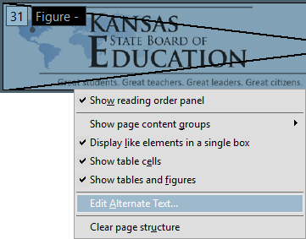
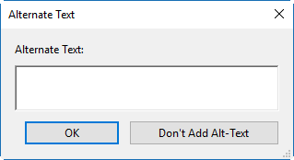
Provide alternative text for images: PDF
For PDF documents, the image must first be designated as a Figure in Acrobat Pro (e.g., using the Touch Up Reading Order tool). Then right click the image and select Edit Alternate Text. Enter the appropriate alternative text in the dialog box.

Slide 33
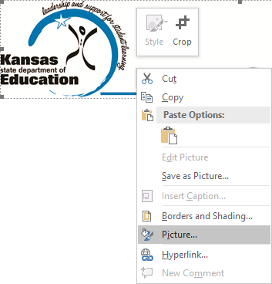
Provide alternative text for images: Word (1)
For Word documents, (1) right click the image in Word and select Picture.
Notes:
Format Picture in earlier versions of Word

Slide 34
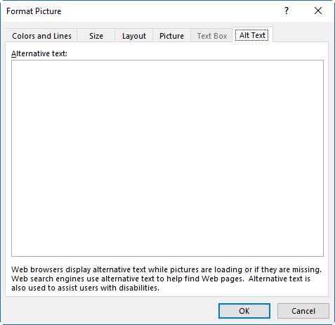
Provide alternative text for images: Word (2)
(2) Click the Alt Text tab. Enter the appropriate alternative text in the Alternative text field.
Notes:
Description field in earlier versions of Word

Slide 35
Provide valid labels for form fields
Form fields must be explicitly associated with labels. When labels are not present or incorrect, users of AT may not be able to complete a form.
Standards
  WCAG 2.0 Level A
    1.3.1 Information and relationships conveyed through presentation
    4.1.2 Name, Role, Value

Slide 36
Provide valid labels for form fields: web
<label for="ship1">Ship To:</label> <input id="ship1" type="text"
name="shiptoaddr1">

Slide 37
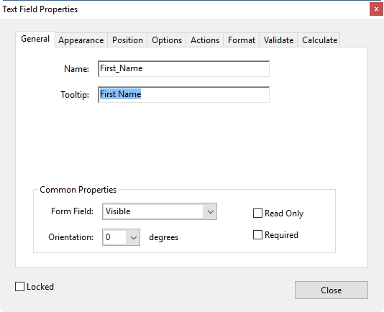
Provide valid labels for form fields: PDF
For PDF documents, use the Tooltip property.
In the Forms panel click Edit, then right click the field and select Properties. Enter the label in the Tooltip field.
Ensure the Tooltip label conveys all the information that a screen reader user would need to correctly complete the field.

Slide 38
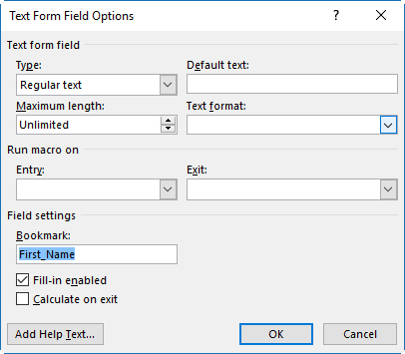
Provide valid labels for form fields: Word (1)
For Word documents, (1) right click the field and select Properties. Enter the label in the Bookmark field.

Slide 39
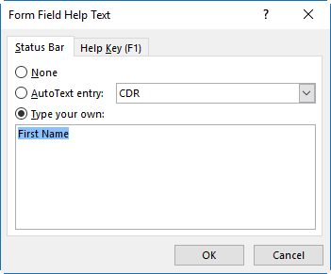
Provide valid labels for form fields: Word (2)
(2) Click the Add Help Text button, then enter the label in the Type your own text field and click OK twice.

Slide 40
Ensure link text is meaningful
Link text should clearly describe the content to be found or action to be performed by the link.
Avoid generic text
  “click here”
  “more info”
Standards
  WCAG 2.0 Level A
    2.4.4 Link purpose

Slide 41
Ensure pages use the title element: web
Each page must have a title that is clear, concise, and context-relevant.
Standards
  WCAG 2.0 Level A
    2.4.2 Page Titled
<title>Page Title</title>

Slide 42
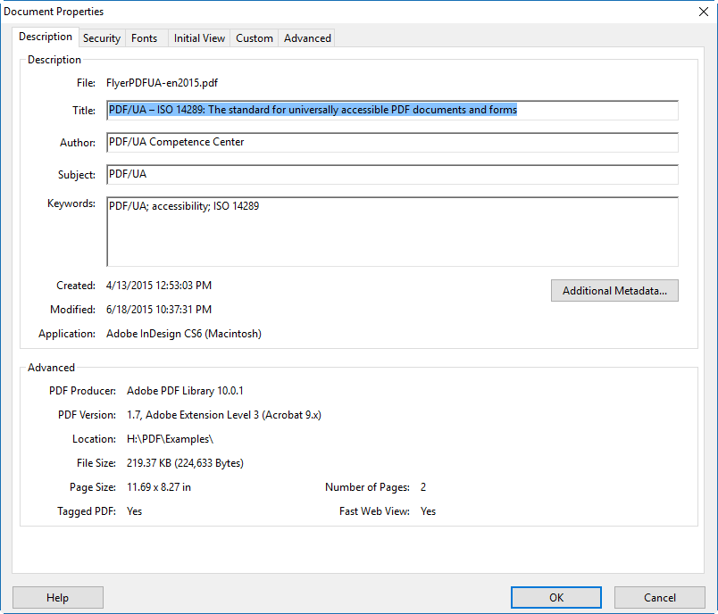
Ensure pages use the title element: PDF
For PDF documents, choose File ► Properties from the Acrobat Pro menu bar, click the Description tab in the Document Properties dialog box, and enter the Title in the Title field.

Slide 43
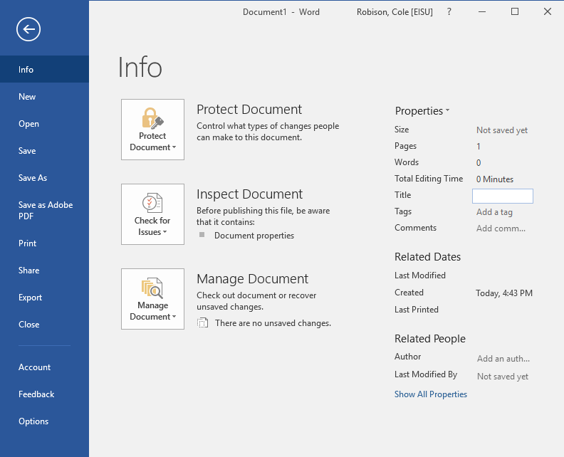
Ensure pages use the title element: Word
For Word documents, Click File, then enter the Title in the Title field.

Slide 44
Word: Document Structuring
Using built-in document structuring features, rather than typography for formatting, is key to many Word accessibility techniques.
For example:
  Use the default heading styles provided for “true headings” instead of just bolding and/or enlarging ordinary text.
  Use tables instead of aligning text with tabs.
  Use the built-in list features for lists.
  Start a new page by inserting a page break instead of repeated hard returns.

Slide 45
PDF: Tags
In order for a PDF file to be accessible, it must, at a minimum, be tagged.
PDF tags provide a hidden structured, textual representation of the PDF content that is presented to screen readers. They exist for accessibility purposes only and have no visible effect on the PDF file.
Tags can be produced when the PDF is created, or added to a document using autodetection.
In either case, editing the tags for sematic accuracy and full accessibility is usually required.

Slide 46
Testing Tools
The W3C provides a comprehensive list of web accessibility evaluation tools that is searchable and sortable at https://www.w3.org/WAI/ER/tools.

Slide 47
AMP
Accessibility Management Platform (AMP) is a web-based platform for the testing, implementation, and management of accessibility across an enterprise.
AMP’s primary functionality is designed to manage all accessibility testing and reporting work in one location.

Slide 48
PAC 2
For checking PDF accessibility, I recommend the free PDF Accessibility Checker (PAC 2) from Access for All.
  http://www.access-for-all.ch/en/pdf-lab/pdf-accessibility-checker-pac.html
The 508 PDF Help Center is a good resource for learning how to resolve many of the common errors and warnings it reports.
  https://taggedpdf.com/508-pdf-help-center/
Notes:
Access for All is a Swiss independent non-for-profit organization for accessibility and inclusion.

Slide 49
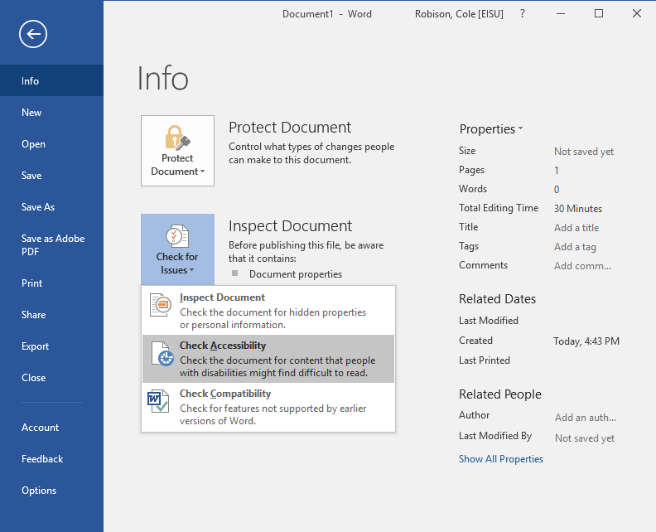
Word Accessibility Checker
Word has an accessibility checker built in.
Click File, then Check for Issues, then Check Accessibility.

Slide 50
Additional Resources: KPAT
Kansas Partnership for Accessible Technology (KPAT)
  Established by Executive Order 08-12, the KPAT addresses web and information technology accessibility issues and provides related policy, standards, guidelines, and procedural recommendations.
  http://oits.ks.gov/kpat
  Helpful technical resources at http://oits.ks.gov/kpat/resources

Slide 51
Advance Questions (1)
Are we required to caption all video materials teachers and students make? (school projects, YouTube posting, website hosted videos)
WCAG 2.0 Level A
  1.2.2 Captions (Prerecorded)
    Captions are provided for all prerecorded audio content in synchronized media, except when the media is a media alternative for text and is clearly labeled as such.

Slide 52
Advance Questions (2)
Are we required to provide captioning for live internet video streaming?
WCAG 2.0 Level AA
  1.2.4 Captions (Live)
    Captions are provided for all live audio content in synchronized media.

Slide 53
Advance Questions (3)
If this is required, are there any software resources available to help with doing these captions?
A good resource for this information is available from the Described and Captioned Media Program (DCMP) at https://www.dcmp.org/ciy/.
The DCMP also makes available a listing of captioning service vendors at https://dcmp.org/ai/10/.
Notes:
The DCMP is funded by the U.S. Department of Education and administered by the National Association of the Deaf.

Slide 54
Advance Questions (4)
Are school management solutions such as PowerSchool ADA compliant and/or do they need to be?

Slide 55
Advance Questions (5)
Schools are using social media to reach patrons and students. Are Facebook, Instagram, and Twitter ADA Compliant? Do posts made by employees on these services need to be ADA compliant? If so, explain.
http://oits.ks.gov/kpat/resources#social

Slide 56
Advance Questions (6)
We use Google Classroom internally to manage classrooms electronically. Is it or comparable solutions compliant?
G Suite Administrator Guide to Accessibility
  https://support.google.com/a/answer/
  2821355?hl=en#h4_classroom
    Features and options
      Supports screen readers
      Keyboard accessible

Slide 57
Advance Questions (7)
I understand that public facing web pages need to be ADA compliant, what about a portal that is only visible to the district and used for internal purposes?

Slide 58
Advance Questions (8)
SOCS is one example of a solution that provides tools to make web sites ADA compliant. I believe some tech directors think that is enough to be compliant. I’m thinking that anyone posting on that site needs to know about things such as closed captioning, etc. What should schools make sure to do at a minimum?

Slide 59
Advance Questions (9)
What tools do you recommend to audit and develop ADA compliant content?

Slide 60
Advance Questions (10)
If a teacher links to a public YouTube clip and it does not have closed captioning, what should we do? Should they use it or not?

Slide 61
Advance Questions (11)
If and when a district gets some sort of audit, what is the minimum that has to be done? What are the steps to take to get to compliance and beyond?
If you get a complaint / legal inquiry
  Counsel is critical
  Ensure you have an issue resolution policy for addressing complaints and legal inquiries
  Your legal counsel can create a plan, possibly alongside a technical consultant

Slide 62
Advance Questions (11) (continued)
Recommended steps:
  Establish a compliance timeline
  Implement an accessibility standard
  Define an accessibility organization
  Implement a digital accessibility policy
  Publish an accessibility statement
  Provide a digital accessibility support process
  Train your organization
  Audit & report on outcomes
  Adopt policy to handle accessibility bugs with the same priority as other bugs
Cf. Public Sector Organizations: Taking the Mystery out of ADA Compliance presentation available for download from http://info.ssbbartgroup.com/CSUN2017

Slide 63
Other Questions?

Slide 64
Questions and Assistance
Cole Robison
Director of IT Accessibility
Office of Information Technology Services
(785) 291-3016
cole.robison@ks.gov

