Slide 1

Video Equipment
Status, Problems, and Solutions

Slide 2
Definitions
Streaming – Sending a camera signal through a computer, onto the internet, to another computer
HDMI – High Definition Multimedia Interface, video/audio/data through one cable
A/D – Analogue to Digital converter, converts video (tape) signal into computer data
Component – Standard Cable TV cable
RCA – three lead [red/white/yellow]VCR cable
Single Pin – Video and Audio over a single cable

Slide 3
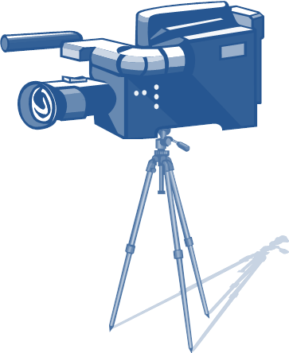
Video Data Flow
Camera to Laptop
Laptop to Server
                Server to Internet

Slide 4
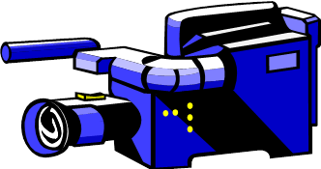

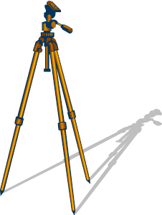
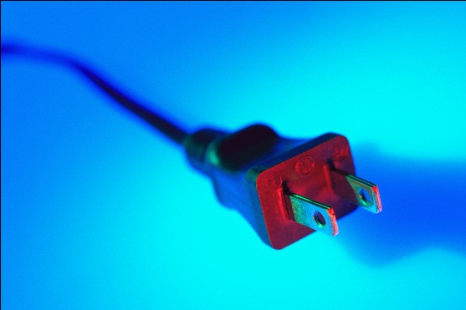
Old System Failuer
Battery Charger Failed, no replacement available¹.
Cannot charge batteries, cannot run from wall current
1 EBay has several, but they are not an authorized State Supplier

Slide 5
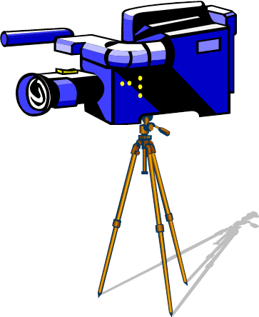

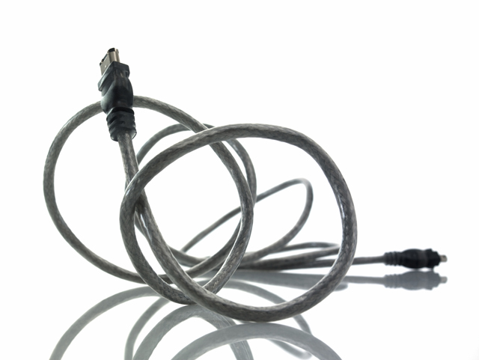
Old Camera Difficulties
1. Cables [Firewire requires an adapter card]
2. Recording Media [Mini DV is obsolete]
3. Converting from a tape to computer is resource intensive

Slide 6

New Camera Plusses
New Camera Minuses
High Definition Data Rate > Streaming Data Rate
USB Compatibility only useful for downloading video; will not work for streaming
HDMI output [which can be streamed] requires expensive A/D converter
Camera has stereo sound outputs; computer has single channel [mono] audio input
Native recording format very difficult to edit
USB Compatible
Uses Mini-SD Cards
High Definition
Professional Appearance
Professional Microphone
inputs and outputs

Slide 7
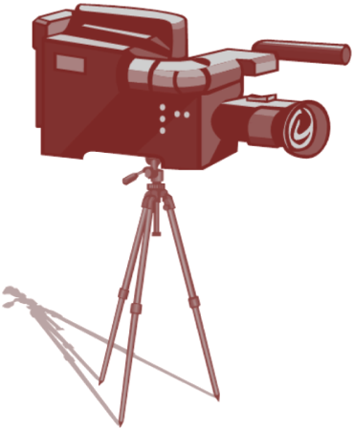

Interim Solution
A Pinnacle A/D converter was purchased and the software was installed. This allows video from the camera to be streamed through an SD Component cable using off the shelf cabling.
This produces a Standard Definition signal, usable by the streaming system.
A second cable captures sound from the camera and sends it to the streaming computer.
Sound
To Internet
Video

Slide 8
Current Difficulties
Camera has two audio channels – left and right.
Expression Encoder 4 [free] has very crude editing capabilities.
Pinnacle Studio has long render times [x3-x4]
The Pinnacle A/D converter is not properly installed

Slide 9
REMEMBER THE MANTRA
MICROSOFT
CHEAP
GOOD
CHOOSE TWO

Slide 10
Solution One:
Record in single channel audio, convert to dual mono
Pros:
Stereo is not normally necessary for a presentation’s message
The audio is simply stripped out, copied, and pasted into the second channel
This is a one-button operation in Pinnacle Studio
In house recording sessions [“podcasts”] are free to use two microphones for left and right.
Cons:
Mixing in audiences or second speakers will be inelegant, and -
Expression Encoder 4 [free] does not allow audio mixing of any type
Pinnacle requires $50+ plugins to perform this feat
Camera requires two cables for signal

Slide 11
Solution Two:
Fully install the Pinnacle A/D converter and software
Pros:
Dual channel audio as intended
Single data cable from camera to converter to computer
Professional software suite helps produce professional results
Software is already purchased
Add-ons nice but not necessary
Cons:
The Add-ons are not free, and cost $40-$50 each
Windows 7 may not allow proper installation of hardware, plus
Will likely require intensive IT involvement
Software would need to be installed on two machines (the streaming computer and the rendering computer) which may require a second license [~$80], and/or –
The laptop will require a larger hard drive.

Slide 12
Solution Three:
Buy HDMI A/D Converter
Pros:
High definition output for recording or streaming
Scales with capability of ancillary systems
Single data cable from camera to converter to computer
Some models feature multiple inputs and output to convert other media types and/or mix inputs and outputs
Cons:
Costs start at $300 and easily runs up to $12-2400
The signal will need to be throttled down to be usable with current systems [too much data]
Depending on converter, software may need to be purchased and/or installed
More clutter on the production site table

Slide 13
Solution Four:
Purchase used battery charger
Pros:
Old proven system ready to go
SD System for road shoots, HD system for ITV room shoots
Low Cost ($40-80)
Cons:
System is 10+ years old, so are chargers.
Repairs unlikely
Only staving off inevitable second failure
All known compatible chargers are sold ‘as is’
Suppliers are outside of State supply system

